Slide 1
Microservice Architecture
Introduction

Slide 2

Who am I?
I am the Founder and President / CTO of Mindfire Technology
We are a Tech company, not a HR company
http://www.MindfireTechnology.com
I am a founding member of Utah Geek Events
Provides training for professionals
Utah Code Camp, Big Mountain Data, Launch Events, etc.
http://www.UtahGeekEvents.com
I am the Co-President of Northern Utah .NET Users Group (NUNUG)
http://www.nunug.org
I have been writing software professionally for the past 20+ years
As a consultant, I've worked with dozens of different companies
I've architected massive-scale projects

Slide 3
What have you heard about Microservices?
Inspired by SOA
Cloud Computing
Small
Scalable
A particular way of designing applications as suites of independently deployable services
Single Responsibility Pattern
Pioneered by Netflix, Amazon, and others.
Notes:
These are some things people told me they thought of when I asked about Microservices
Interface Segregation Principle – the idea of code defined with boundaries

Slide 4
Legacy Approach
Everything is in the same process
Everything is versioned together
Code reuse is at the “Component” level, rather than the “service” level
The app is somewhat “baked” together as a single application.
Process
Users
Orders
Logistics
Fulfillment
Notes:
Versioning modules independently is not really practical.

Slide 5
Microservices Approach
Each Service is it’s own application with it’s own process
Reuse happens at the service level, rather than sharing the “component”
Multiple of each service deployed as necessary to meet demand
Process
Process
Users
Orders
Process
Process
Logistics
Fulfillment
Notes:
Version can happen independently (more on how later)

Slide 6
5 Tenets of Microservices
Small
Single Function
Encapsulated
Independent
Scalable
Notes:
These are the basic tenets of a Microservice. If you’re going to attempt writing one, you should be aware that this is the goal.
Notice reusability is not necessary a tenet.

Slide 7
Small
A granular unit of an application, not an entire application
Small projects are much more successful than large projects throughout the entire SDLC
Simplifies testing for deployment
Makes the rest of the tenets easier or possible
Notes:
Small

Slide 8
Single Function
Single Responsibility Pattern
Does one thing, but does it well
Does not imply nor infer any external considerations
Don’t presume it’s a web app, for example
Allow as much latitude in the use of the service as possible
Notes:
Does not imply nor infer any external considerations:
Web application vs Windows app, etc.
As you try to model a larger domain, it gets progressively harder to build a single unified model. Different groups of people will use subtly different vocabularies in different parts of a large organization.

Slide 9
Encapsulated
Hide the internals / complexity
Allows for change internally without breaking the public interface
Keep your service isolated
We should try to encapsulate a Bounded Context
Notes:
no need to know HOW it does what it does
More on bounded context in a later slide

Slide 10
Independent
Can release independently
No platform dependencies
Can happen with different languages, stacks, etc.
Does not rely on a complex set of configuration
Nate Says:
Does not depend on other services, processes, etc.

Slide 11
Scalable
Fault Tolerant
Easily Deployed
Can have multiple instances running at the same time without causing issues
More instances can help alleviate load
Notes:
Dev Ops
Easily Tested

Slide 12
Downsides
More communication between different parts of the app come at a much higher cost
They form Information Barriers
More difficult to design correctly
New considerations such as network latency, load balancing, fault tolerance, etc. that may have been unimportant now become critical
Increased overall complexity of applications built using these services
Distributed systems are more difficult to design
Difficult to batch disparate services as part of a single transaction
Notes:
Nanoservices is considered an anti-pattern.

Slide 13
Practice Advice
Carefully consider where the boundaries between the domain are
Make your service stateless
Be careful of how you version the service
Don’t have services depend on other services
Adopt an enterprise-wide service discovery scheme
Be careful how you use cross-dependencies
Adopt an Enterprise Service Bus (ESB) as an architectural pattern that complements the Microservice Architecture
Always make a service call asynchronously, they might take some time!

Slide 14
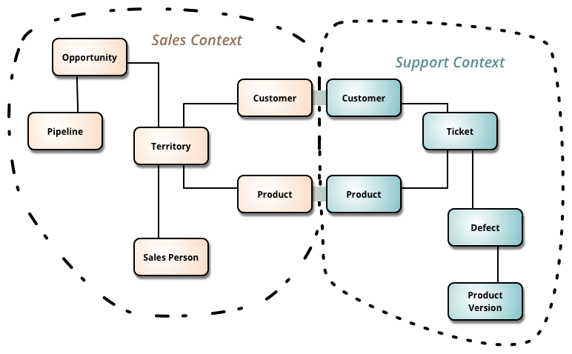
Encapsulated - Bounded Context
A bounded context is a natural separation of one sub-system from another in a set of systems. The idea is to group systems in such a way that boundaries can be drawn between them. These boundaries help with the cohesiveness of the systems.
Notes:
Bounded Contexts have both unrelated concepts and related concepts.
Maybe there is a system where we deal with products, maybe there isn’t

Slide 15
Encapsulated - Bounded Context
A sub-system (Domain) may be shared, but should be avoided where possible
Does it relate more closely to one over another?
Does it belong with some other system or by itself?
Is the system well-defined in scope?
Is it possible that it’s two different domains anyway?
Can the business change the way it treats this domain?
Where are the transactional boundaries?
Notes:
Bounded Contexts have both unrelated concepts and related concepts.
Maybe there is a system where we deal with products, maybe there isn’t
If we share

Slide 16
Encapsulated - Bounded Context
There should be a circle of familiarity
Just like in real life, there are things I would do with spouse, family, friends, in-laws, peers, colleagues, etc.
The further out from one of the inner circles, the more formal the relationship
The same should go for our code
This is also a natural boundary in which we can include or exclude various sub-systems from our service
Notes:
Bounded Contexts have both unrelated concepts and related concepts.
Maybe there is a system where we deal with products, maybe there isn’t
Once we go outside the door, were in “public”. There are context like this

Slide 17
Stateless
Strictly speaking, Microservices do not need to be stateless, but stateless services…
Make the scalability easier
Are more fault tolerant
Have significantly less bugs
Work more in-line with different kinds of applications (web, mobile, desktop, etc.)

Slide 18
Versioning
One of the complexity of allowing independent versioning of the services upon which app(s) reside is versioning
You should be able to have different versions of the microservice deployed simultaneously
The notion of the version should be part of the interface so the caller always gets what he expects
I would suggest semantic versioning
Notes:
Semantic Versioning^{[1]} is a formal convention for specifying compatibility using a three-part version number: major version; minor version; and patch. The patch number is incremented for minor changes and bug fixes which do not change the software's application programming interface (API). The minor version is incremented for releases which add new, but backward-compatible, API features, and the major version is incremented for API changes which are not backward-compatible. For example, software which relies on version 2.1.5 of an API is compatible with version 2.2.3, but not necessarily with 3.2.4.

Slide 19
Single Abstraction Layer
It is best to keep a consistent level of abstraction
If you are going to allow services to call other services, at least understand the implications
Abstractions should be kept uniform for the layer they reside
Low level services should not depend on a higher level service
Don’t use service inheritance, only aggregation
vs
Notes:
Appropriate and consistant level of abstraction

Slide 20
Abstraction
Why do we use abstraction?
To create uniformity among similar objects, to simplify working with those objects
To simplify a set of complex tasks into a single task
Abstraction does not mean adding a passthrough layer into your software
The Tradeoff:
The higher the abstraction, the less reusable the object will become
Abstraction means to simplify!
Simplicity vs Functionality

Slide 21

Notes:
Does anyone remember that lego movie, whatever it’s called?
The thing they feared most was the Kragle. Why? Because it fixes things together limiting the creativity.

Slide 22
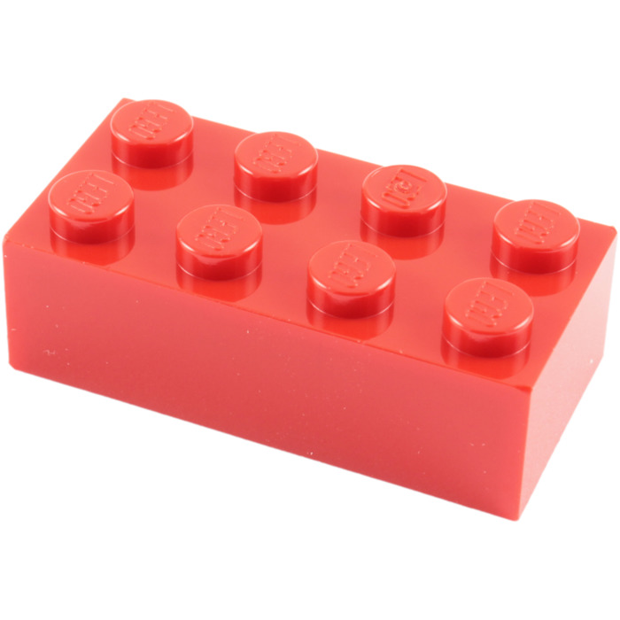
Notes:
This is a good abstraction. It’s extremely flexible, anything can be created with these little guys.

Slide 23
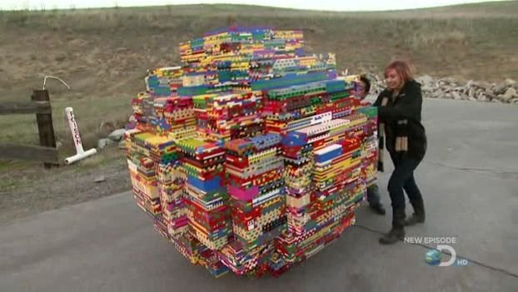
Notes:
Huge round objects….

Slide 24

Notes:
Lego Tigers….

Slide 25
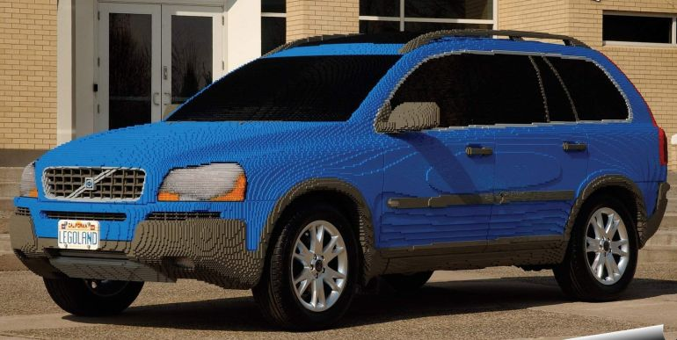
Notes:
Or even Lego Cars….
But imagine if bunches of blocks were glued together. It may be much simpler to assemble the car, but then those bricks could only be useful as car parts. They simplify the putting together the car, but it came at the cost of limiting it’s utility.

Slide 26
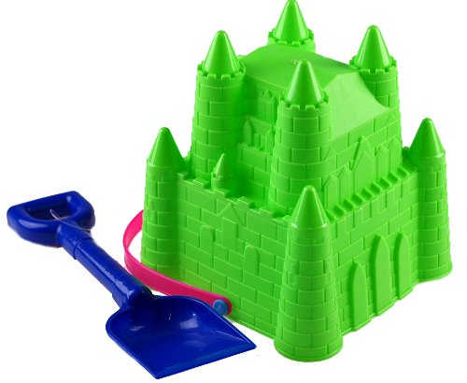
Notes:
This is an example of something who’s form is not very abstract. You can build sand castles with it. That’s all.

Slide 27
Abstraction
Microservices should be Legos --

Slide 28

Service Discovery
A way to discover endpoints for a service
Can help to better understand what apps are dependent on a service or a particular version of the API
Allows services to be moved and/or service instances to be round-robined for load balancing
Usually consists of a “service lookup” service
I am “Website” App
I want “User” service
I want version 4 of the API

Slide 29
Dealing with Cross-Dependencies
Wherever possible, do not let services coordinate work through a database!
Seriously, I cannot stress this enough!
Provide enterprise-wide identities for objects that exist outside of the service
If the ability to guess the next identity is problematic, use a randomized identity
If out-of-order is a problem, use a flake server
Recommend using web-safe identities, just in case
Recommend using human readable identities
IdentityRef - (https://www.nuget.org/packages/Mindfire.IdentityRef/)

Slide 30
Dealing with Cross-Dependencies
Only keep basic information along with the ref. Do not attempt to “adopt” these objects in your application
You could provide models / interfaces / service discovery as part of an SDK
Be careful not to duplicate the functionality
Be careful not to version simply to provide a different/special implementation for an application
Usually finding better boundaries between different modules of software eliminates most cross-dependency issues

Slide 31
Use an Enterprise Service Bus
Helps services to coordinate without the need of calling each-other
Provides some robustness for a message once it has been received by a service
One message delivered to only one service for processing, even if there are currently multiple instances of that service currently running
Allows a form of bi-directional communication between modules
Allows topics to be combined into an epic
Allows for a kind of transactional structure
Easy to swap out systems because there is no set interface
Easy to hook into existing software

Slide 32

Questions?

Slide 33
Thanks!
Slides available at http://github.com/NUNUG

Slide 34
References
https://www.martinfowler.com/articles/microservices.html
https://www.martinfowler.com/bliki/BoundedContext.html
https://opensource.com/article/17/5/hardest-part-about-microservices-your-data

Slide 35
Micro
Adjective
extremely small.
minute in scope or capability.

Slide 36
Service
Noun
the action of helping or doing work for someone.
a system supplying a public need such as transport, communications, or utilities such as electricity and water.

Slide 37
Conclusion
Micro means small
Service means to do something
A microservice is a small thing that does stuff

Slide 38
Thanks for coming!

Slide 39
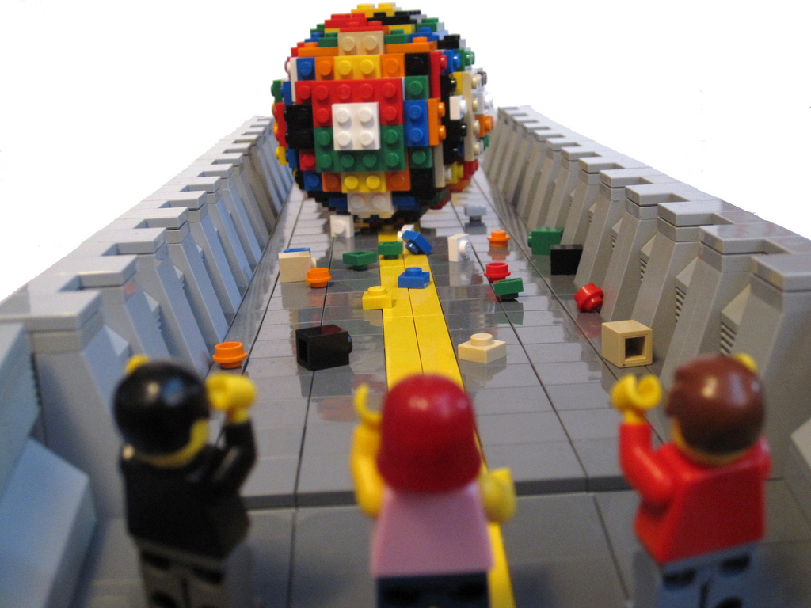

Slide 40
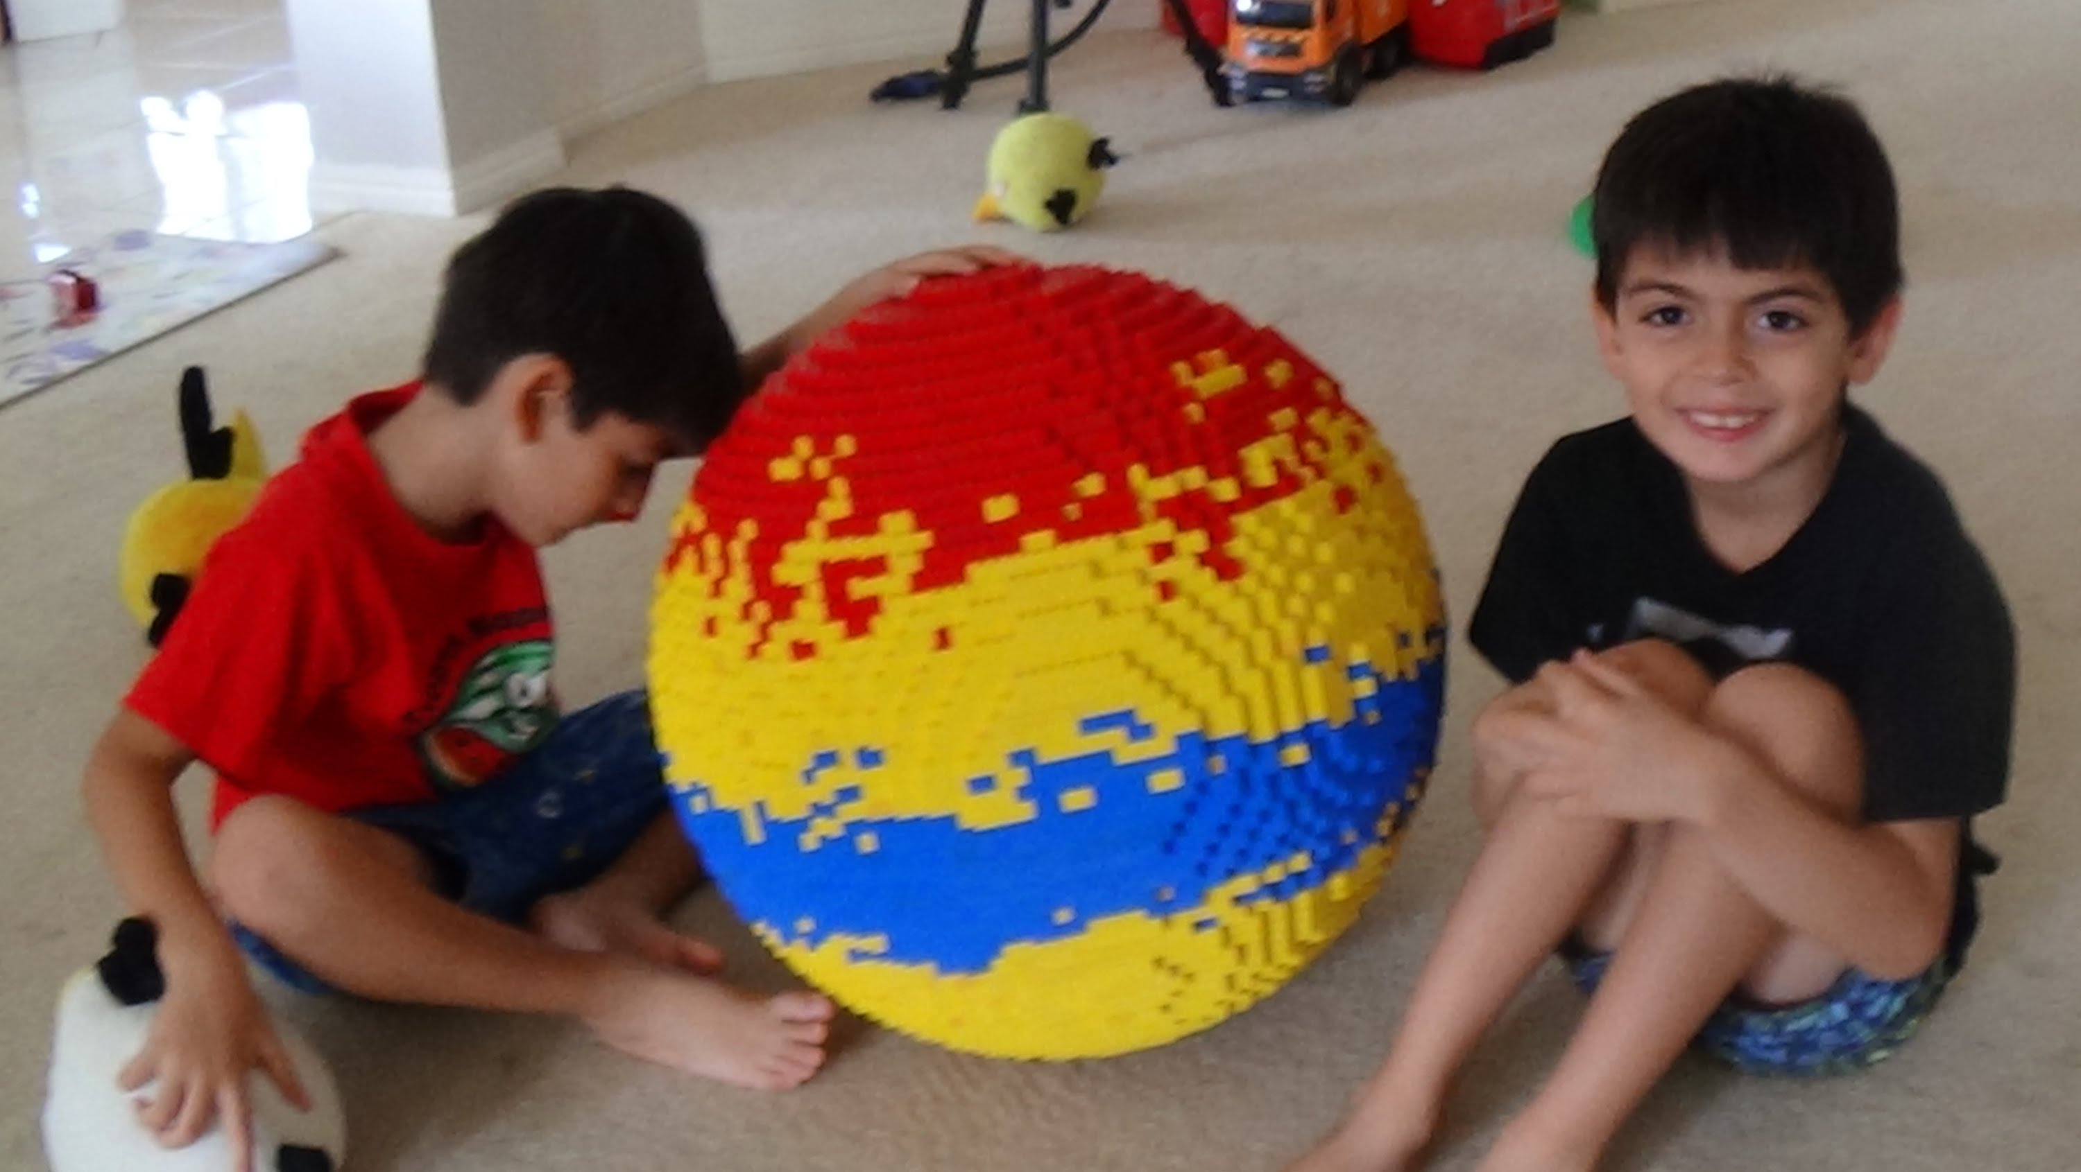

Slide 41
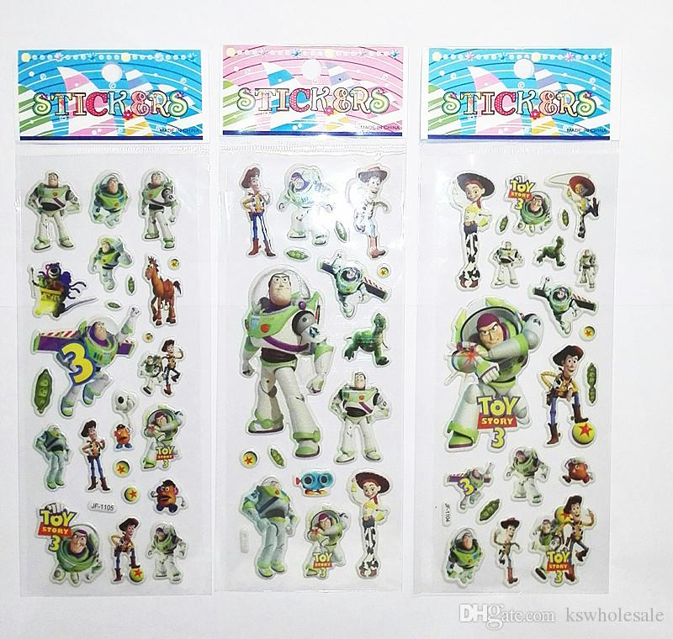
Notes:
This is another example of something

